Slide 1
User Guide: Automated Cloud AI Model Training Table of Contents
Introduction
System Requirements
Getting Started
Uploading Dataset
Setting Training Parameters
Software Specifications Documentation
Blockers and Workarounds

Slide 2
Introduction
Welcome to the Automated Cloud AI Model Training user guide. This guide will walk you through the steps to use the C# Windows Form application to train an AI model online. The trained model will be in the .onnx format, using the YOLOv5 model architecture.

Slide 3
System Requirements
Operating System: Windows 10/11
Target .NET Framework: 4.8
AI Training-capable PC
Internet connection for online training

Slide 4
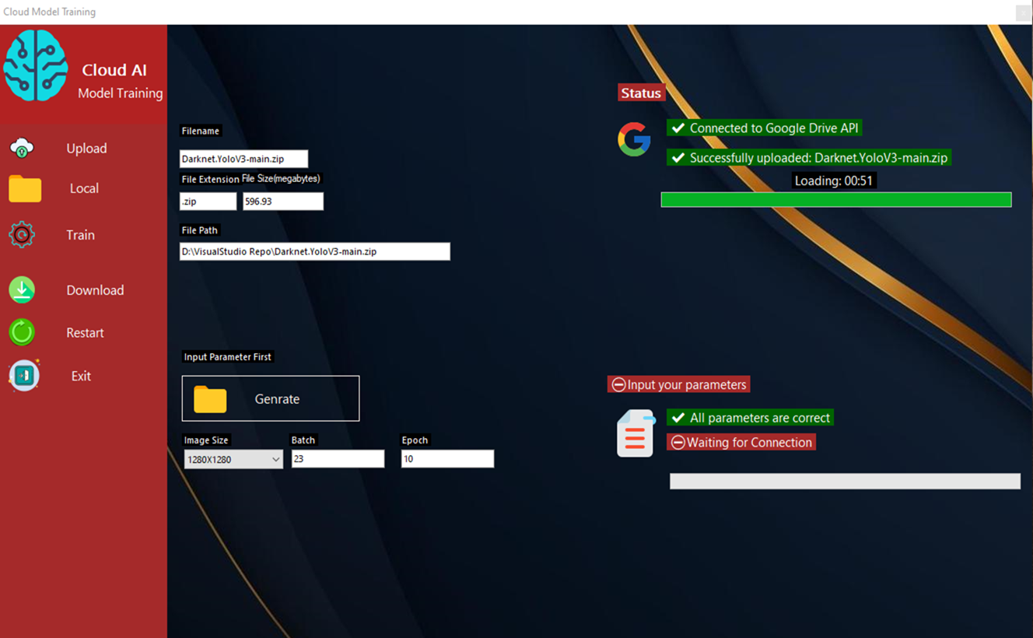
Getting Started
Install Launch the C# Windows Form application.
Navigate to the "Upload Dataset" section.
Click on the "Browse" button to select the dataset to be used for training.

Slide 5
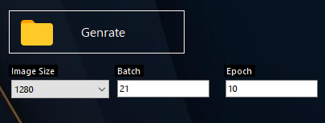
Setting Training Parameters
Move to the "Training Parameters" section.
Set the desired training parameters, including epochs, batch size, and any other settings required for training.

Slide 6
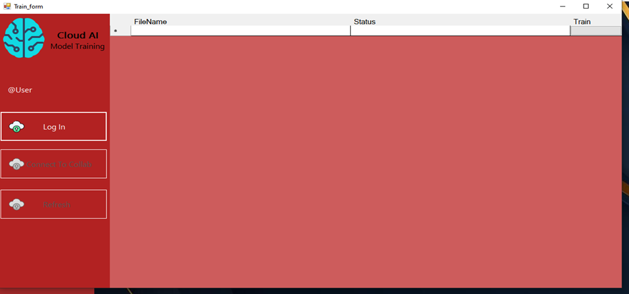
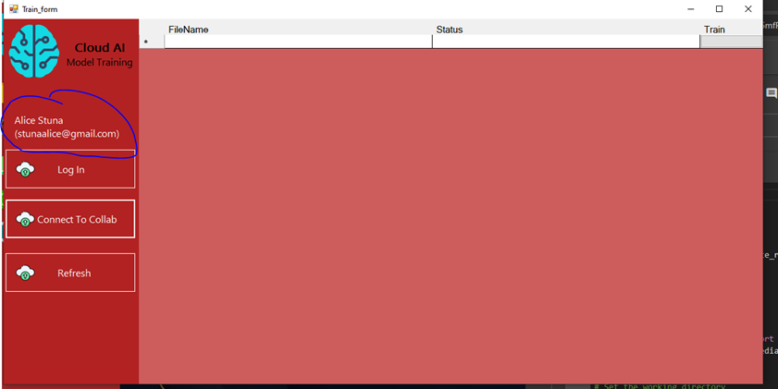
Log In
Click train and Log in Screen it will prompt the user to sign its google account and if the user successfully log in it will display its email and Name in forms
And I the button connect to Google collab will enabled

Slide 7
Connect to collab
Click connect to Collab and Refresh and press train

Slide 8
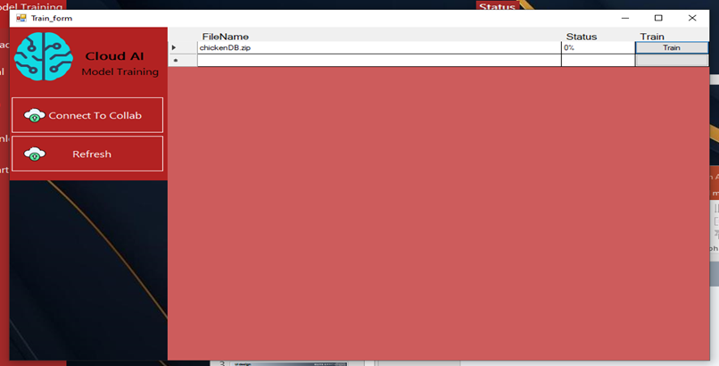
Connect to collab
A dataset will show press train

Slide 9
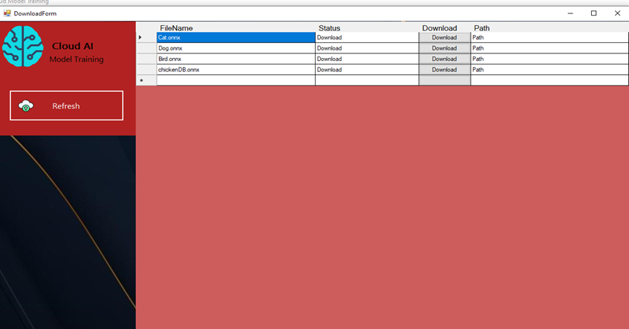
Download Onnx File
After that press Download Button to download Onnx file

Slide 10
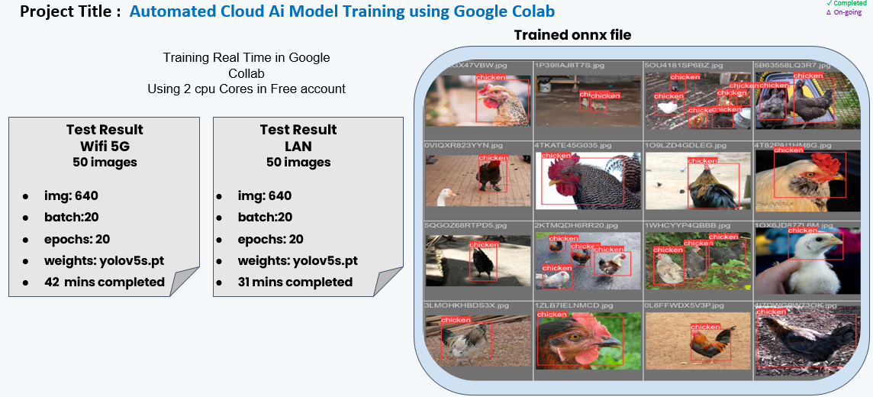
Documentation
Training results and evaluation.

Slide 11
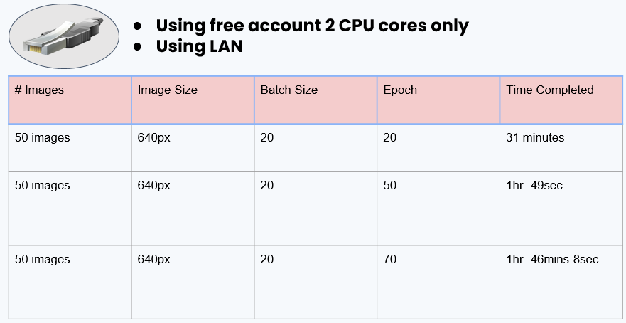
Duration of the training when deployed online.

Slide 12
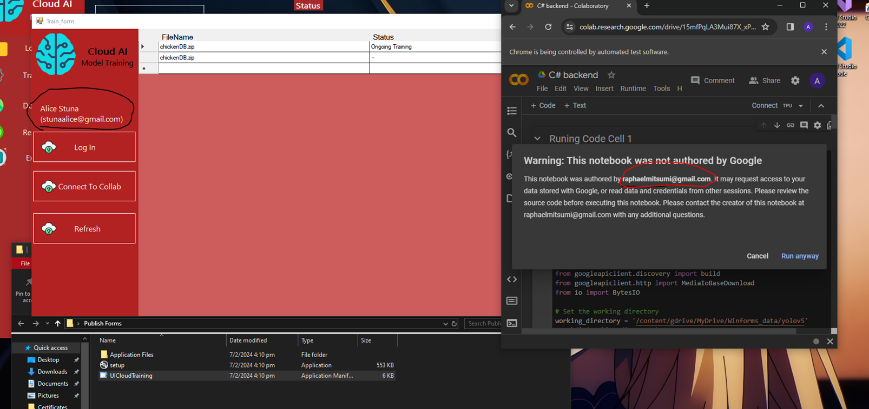
Blockers and Workarounds
Google Collab Permission Prompt: When using different Google accounts, Collab may ask for permission, causing issues with Selenium automation. Current workaround: Manually handle the permission prompt.

Slide 13
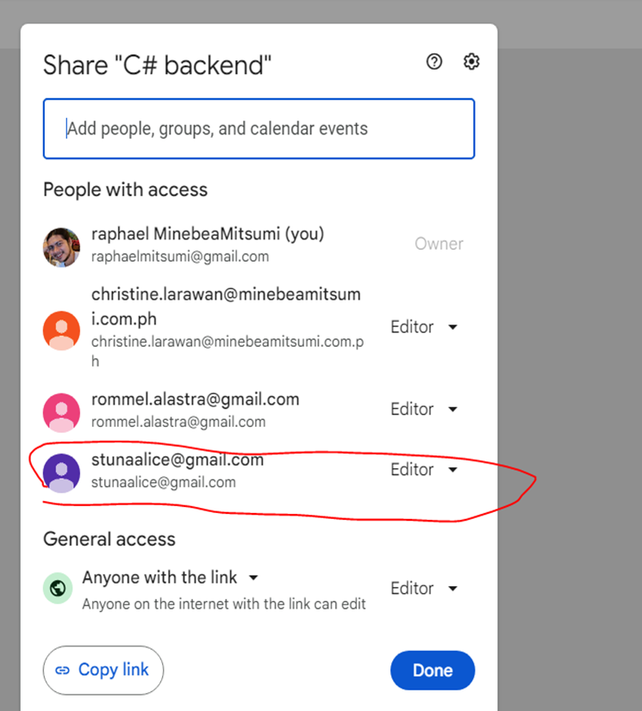
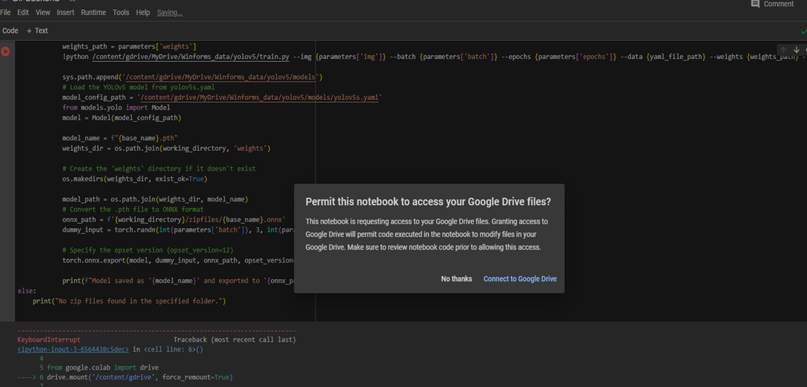
Blockers and Workarounds
Google Chrome New Window Popup: Adding a new user as an editor in Collab triggers a new Chrome window, prompting the user again. Current workaround: Manually click the prompt in the new Chrome window.

Slide 14
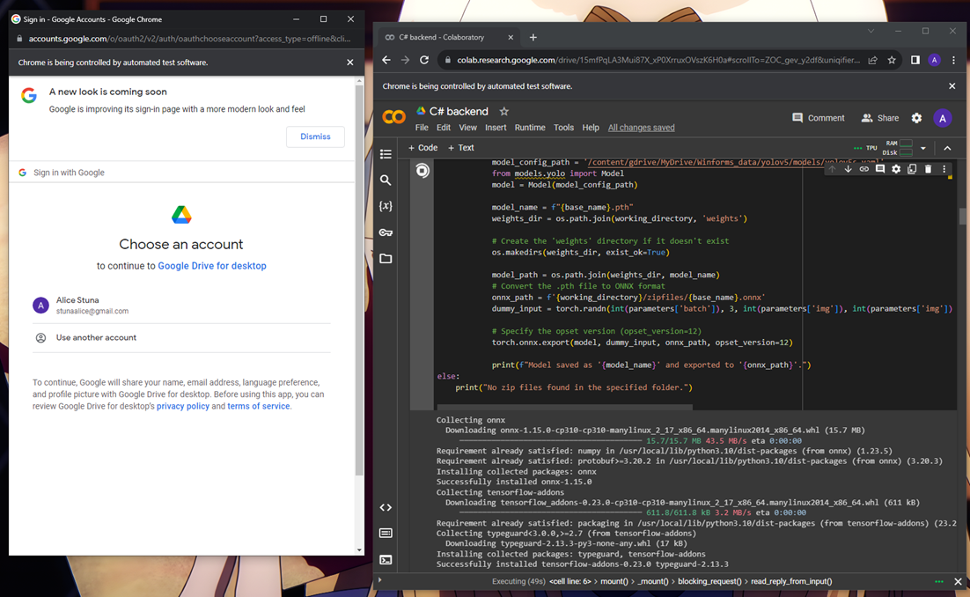
Blockers and Workarounds
Security Measures in Google Prompt: A new window of Chrome for user verification and checking boxes can't be automated or hidden. Researching API solutions for communication with Google's security measures

Slide 15
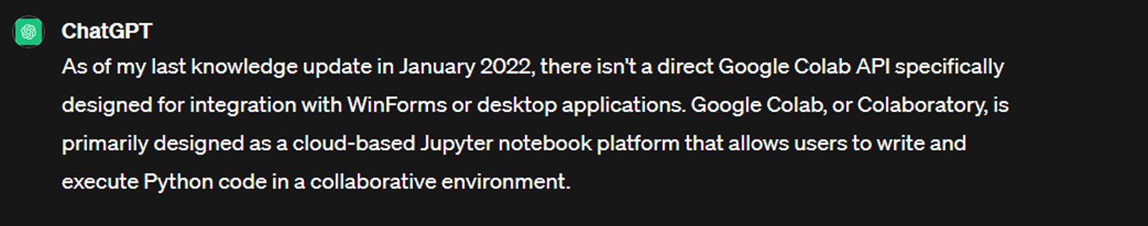
No Current Solutions for this Blockers
Currently Working and Researching for Blockers solution and heres the result for my update last week. Here im looking for API to communicate to google Security measures which selenium cant do.
Using ChatGPT -Results

Slide 16
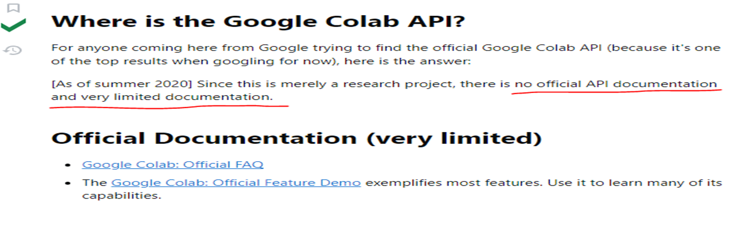
No Current Solutions for this Blockers
StackOverflow-Results

Slide 17
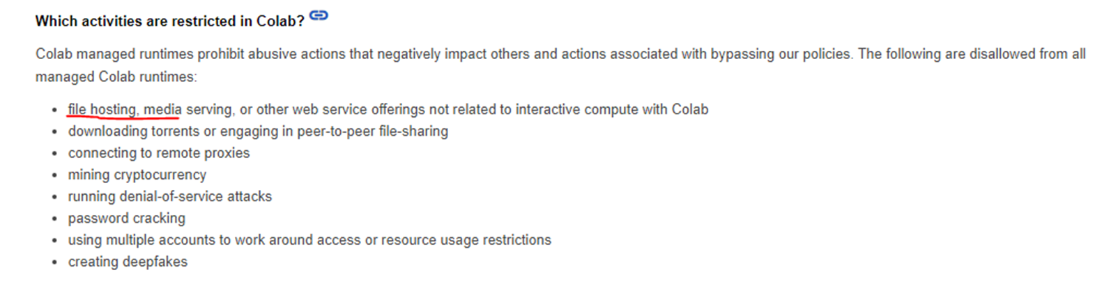
No Current Solutions for this Blockers
Google Collab Documentation-Results
During research I found out that file hosting is not possible to control collab

Slide 18
Reference
https://stackoverflow.com/questions/50595831/google-colab-api
https://research.google.com/colaboratory/faq.html

